Slide 1

Student Recognition & Data collection application
Team Members Details
1.S.John daniel - 20N31A6922
2.L.Hemanth Reddy-20N31A6931
3.T.Sai Kumar Reddy-20N31A6954
4.M.Jayendra - 21N35A6904
III Year B.Tech – CSE - IOT
Under the Guidance of
Mrs M.Aruna
Asst.professor , Emerging Technologies
B.Tech III Year – I Sem | Application Development – 1 | External Project Review

Slide 2
Abstract
This technology can be used to identify the students in the campus premises and also have a look at there data ( ex: name,images, roll-no and etc...).
We can identify the students and there activities in campus premises so that if any students have behaved in an wrong manner they can be identified and action can be taken against them.
This technology can be used in an app on computer which is having connection with the security cameras or a mobile phone.
The data that can be stored in the back end files and that can be retrived based on the recognized student.

Slide 3
Introduction
Student Recognition and Data Collection Application System .
It is a way of identifying or confirming an individual’s identity and the main aim of the project is to detect and recognise the images that we have stored priorly in the database.
Where in the Data Collection application,with the help of application we can store the personal information related to multiple persons with an high efficiency manner.Data is nothing but name , rollno, department,healthdocuments,subpdfs,documents etc…
By using this application we can identify the students in the college premises.

Slide 4
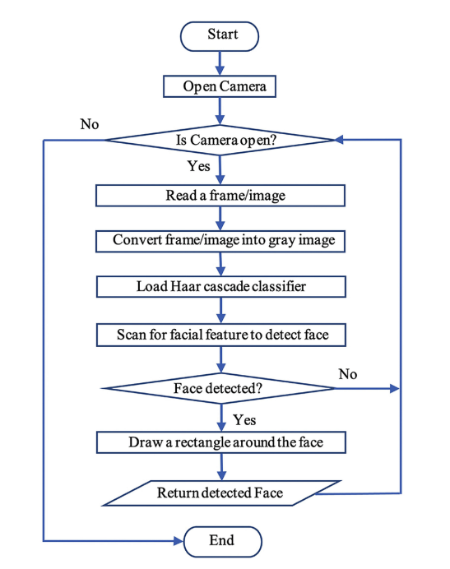
Existing System
Structure of Existing System
Drawback :-
• Sometimes it is difficult for a
person to detect a single student
In a college.

Slide 5
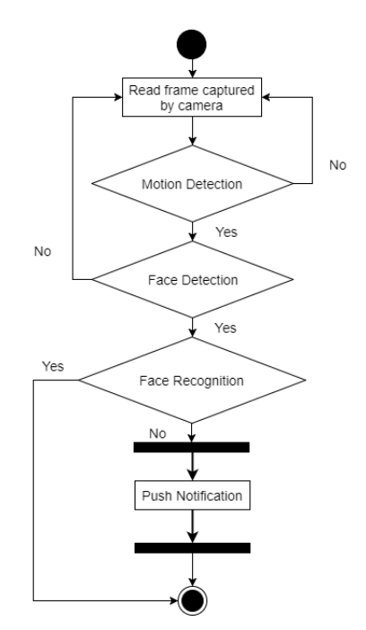
Proposed System
That we are resolved based on
Increasing the recoginization
strength when it recognise the
student.

Slide 6
Architecture Diagram or
System Diagram

Slide 7
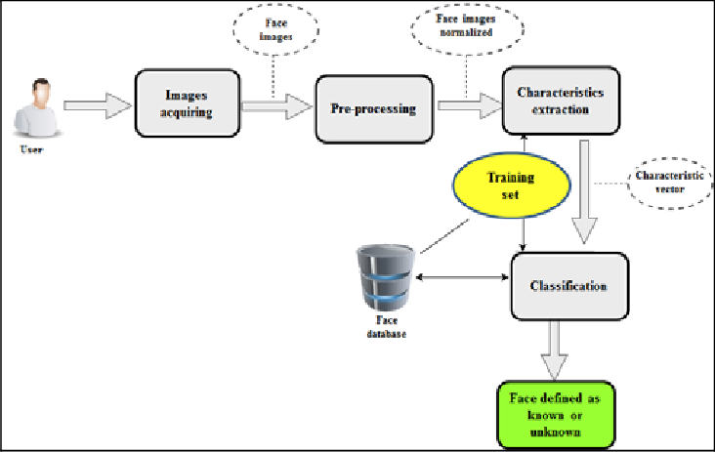
System Architecture

Slide 8
Software Requirements Specification (SRS)

Slide 9
Software Requirement Specifications (SRS)
IDLE Installation : Anaconda IDE
Operating System : Windows 10→Visual Studio Code
Coding Language : Python IDE
Tool : Jupyter Notebook
Packages : Os, OpenCV, pandas,tkinter

Slide 10
Hardware Requirement Specifications (HRS)
Monitor :14’ color monitor
Mouse : Optical Mouse
RAM : 4 GB
Tools Used : Integrated camera
System : Intel Core i5 7th gen

Slide 11
Application Modules
There are three modules.
Module -1 : Login Screen module
-which is used to access for the user.
Module -2: Information module
-that shows the related information of recognized student.
Module -3: Back-End Module
-which is use for storing the information and processing the information.

Slide 12
Implementation
Id = txt.get()
name = txt2.get()
if ((name.isalpha()) or (' ' in name)):
cam = cv2.VideoCapture(0)
harcascadePath = "haarcascade_frontalface_default.xml"
detector = cv2.CascadeClassifier(harcascadePath)
sampleNum = 0
while (True):
ret, img = cam.read()
gray = cv2.cvtColor(img, cv2.COLOR_BGR2GRAY)
faces = detector.detectMultiScale(gray, 1.3, 5)
for (x, y, w, h) in faces:
cv2.rectangle(img, (x, y), (x + w, y + h), (255, 0, 0), 2)
# incrementing sample number
sampleNum = sampleNum + 1

Slide 13
cv2.imwrite("TrainingImage\ " + name + "." + str(serial) + "." + Id + '.' + str(sampleNum) + ".jpg",
gray[y:y + h, x:x + w])
# display the frame
cv2.imshow('Taking Images', img)
# wait for 100 miliseconds
if cv2.waitKey(100) & 0xFF == ord('q'):
break
# break if the sample number is morethan 100
elif sampleNum > 80:
break
cam.release()
cv2.destroyAllWindows()

Slide 14
System Models
(UML Diagrams)

Slide 15
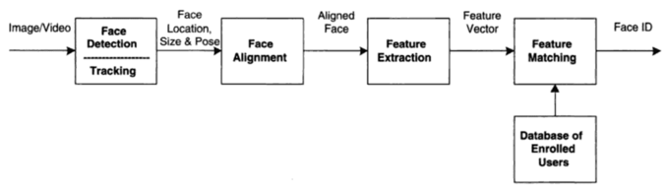
Dataflow Diagram

Slide 16
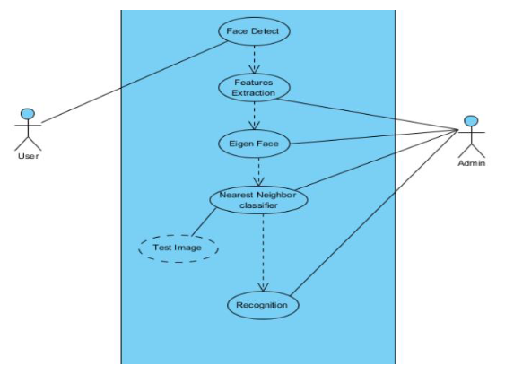
Use-Case Diagram

Slide 17
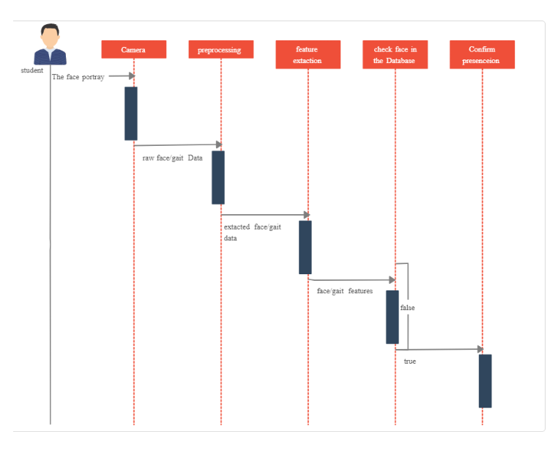
Sequential Diagram

Slide 18
Output Screens

Slide 19
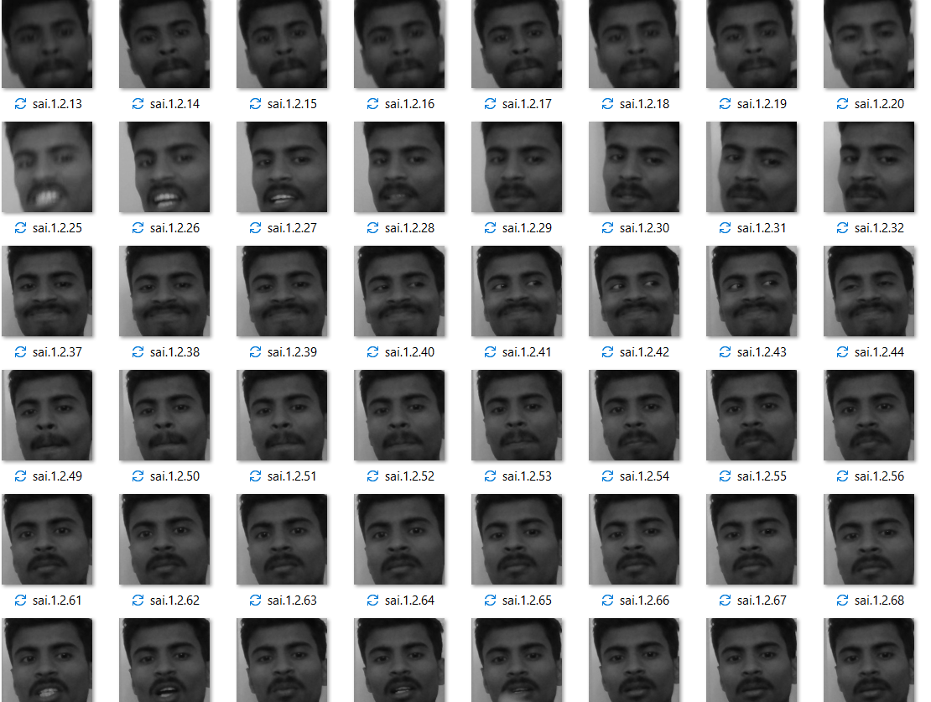
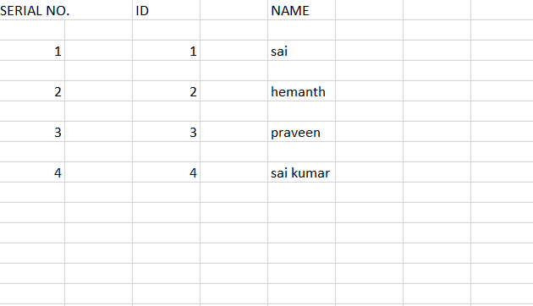
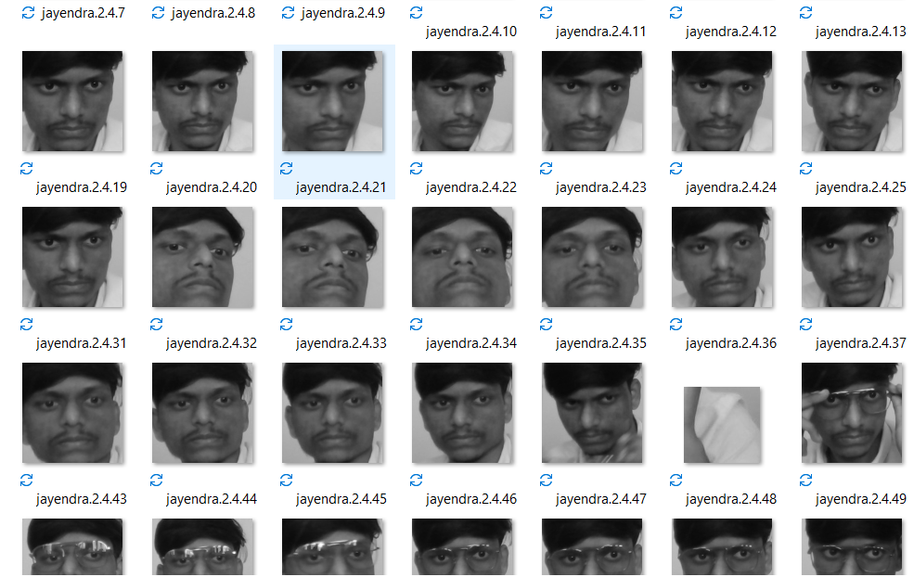
Results (Output Screens)

Slide 20
Application Testing

Slide 21
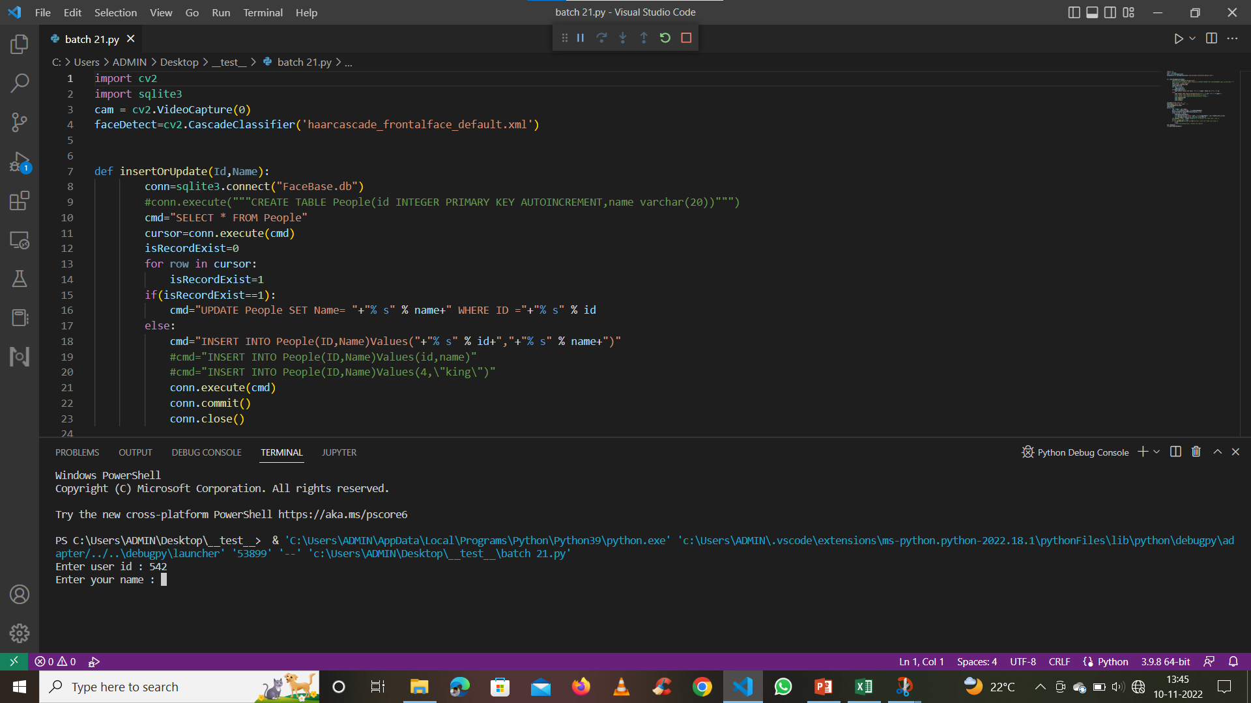
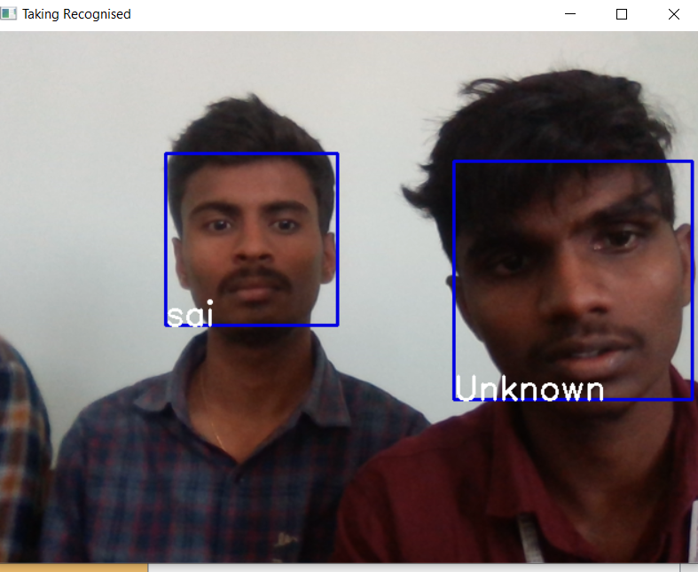
Test Cases (If you have conducted Testing)

Slide 22
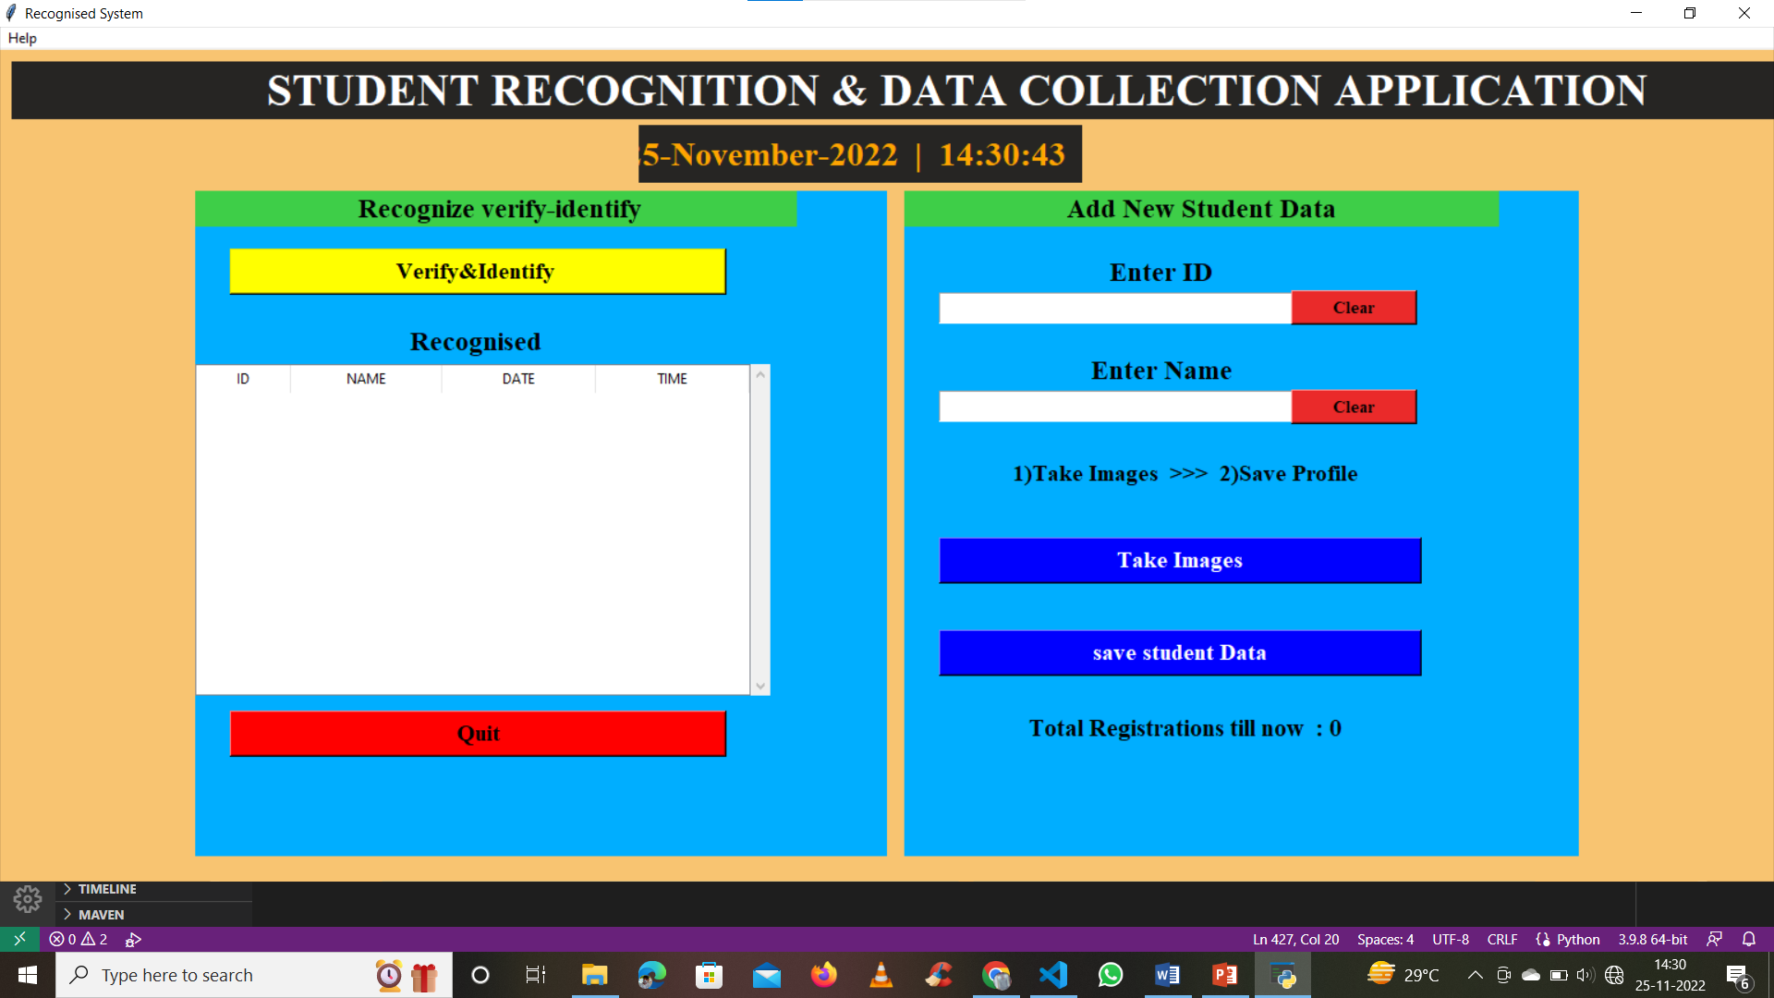

Slide 23
Conclusion &
Future Scope

Slide 24
Conclusion
In order to create this system first we will have to make the datasets. When the image quality becomes favourable different procedures will take place in the face recognition system the tasks are performed using the python .
The input will be taken from the dataset which will be received. There will be precision formatting in the system wherein face embedding for each face will occur. Secondly a file will contain all the required methods and the techniques for the process of identification of the face of the person from the given image of the dataset.
We will store the datasets of the images gathered in excel file

Slide 25
Future Scope
In Future we can also find the system to detect the voice. Voice detection helps in
identifying if whether anyone is passing the examiner answers orally during examination. It
helps in identifying the second person in the room where the examinee is writing exam which
avoids any other malpractices possible by that method.
Push notification to an particular person.

Slide 26
Thank you
T.Sai Kumar Reddy
M.Jayendra
L.Hemanth Reddy
S.John daniel

